Slide 1
A+ Computer Science
Graphics

Slide 2
Graphics
Frame / JFrame
Canvas / JPanel
The Frame is used to hold up / display a Canvas or Panel.
Notes:
Frame / JFrame Objects are used to hold up / display Canvas and JPanel Objects. All drawing occurs on the Canvas / JPanel. The JFrame simply provides a place to show Canvas / JPanel after the drawing has occurred.

Slide 3
Graphics
0,0
X goes across
Y
goes
down
639,479
window.fillRect( 10, 50, 30, 70 );
Notes:
Notice the Graphics screen being used with Graphics class does not use Cartesian coordinates. X goes across and Y goes down. X starts at 0 and goes to MAXX which in this case is 640. Y starts at 0 and goes down to MAXY which in this case is 479.

Slide 4
Graphics
X goes across
0,0
X=100 y=100
Y
goes
down
width=50 height=50
window.fillOval( 100, 100, 50, 50 );

Slide 5
Passing Parameters
A parameter/argument is a channel used to pass information to a method. setColor() is a method of the Graphics class that receives a Color.
void setColor(Color theColor)
window.setColor( Color.RED );
method call with parameter
Notes:
Most, if not all, of the Graphics class methods require parameters.
The parameters communicate to the Graphics methods information about what needs to be done.
The setColor() method changes the current drawing color to the color passed in.
setColor() cannot be called without a Color parameter.

Slide 6
Passing Parameters
void fillRect (int x, int y, int width, int height)
window.fillRect( 10, 50, 30, 70 );
method call with parameters
Notes:
The fillRect() method requires four pieces of information. fillRect() needs an x value, a y value, a width, and a height. fillRect() will draw a filled rectangle on the window at x,y with height and width as stated by the parameters.

Slide 7
Passing Parameters
void fillRect(int x, int y, int width, int height)
window.fillRect( 10, 50, 30, 70 );
The call to fillRect would draw a rectangle at
position 10,50 with a width of 30 and a height
of 70.
Notes:
The fillRect() method requires four pieces of information. fillRect() needs an x value, a y value, a width, and a height. fillRect() will draw a filled rectangle on the window at x,y with height and width as stated by the parameters.

Slide 8
Graphics frequently used methods
Name | Use
drawLine(a,b,c,d) | draws a line starting at point a,b and going to point c,d
drawRect(x,y,w,h) | draws an unfilled rectangle at spot x,y that is w wide and h tall
fillRect(x,y,w,h) | draws a filled rectangle at spot x,y that is w wide and h tall
import java.awt.Graphics;
import java.awt.Color;
import javax.swing.JFrame;

Slide 9
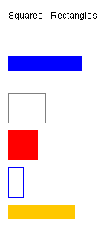
Rectangles
window.setColor(Color.BLUE);
window.fillRect(100, 100, 100, 20 );
window.setColor(Color.GRAY);
window.drawRect(100,150,50,40);
window.setColor(Color.RED);
window.fillRect(100,200,40,40);
window.setColor(Color.BLUE);
window.drawRect(100,250,20,40);
window.setColor(Color.ORANGE);
window.fillRect(100,300,90,20);
Notes:
The paint() method is typically doing the most drawing. Other methods may be called from paint() as well.

Slide 10
Graphics frequently used methods
Name | Use
setColor(x) | sets the current drawing color to x
drawString(s,x,y) | draws String s at spot x,y
drawOval(x,y,w,h) | draws an unfilled oval at spot x,y that is w wide and h tall
fillOval(x,y,w,h) | draws a filled oval at spot x,y that is w wide and h tall
import java.awt.Graphics;
import java.awt.Color;
import javax.swing.JFrame;
Notes:
The Java Graphics class has many useful methods. The chart above lists the most common methods we will be using.

Slide 11
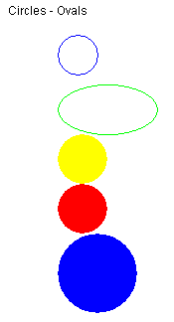
Circles
window.setColor(Color.BLUE);
window.drawOval(100,50,40,40);
window.setColor(Color.GREEN);
window.drawOval(100,100,100,50);
window.setColor(Color.YELLOW);
window.fillOval(100,150,50,50);
window.setColor(Color.RED);
window.fillOval(100,200,50,50);
window.setColor(Color.BLUE);
window.fillOval(100,250,80,80);
Notes:
The paint() method is typically doing the most drawing. Other methods may be called from paint() as well.

Slide 12
Graphics frequently used methods
Name | Use
drawArc(x,y,w,h,startAngle,arcAngle) | draws an arc at spot x,y that is w wide and h tall
fillArc(x,y,w,h,startAngle,arcAngle) | draws a filled arc at spot x,y that is w wide and h tall
startAngle specifies the start of the arc arcAngle specifies the length of the arc
import java.awt.Graphics;
import java.awt.Color;
import javax.swing.JFrame;

Slide 13
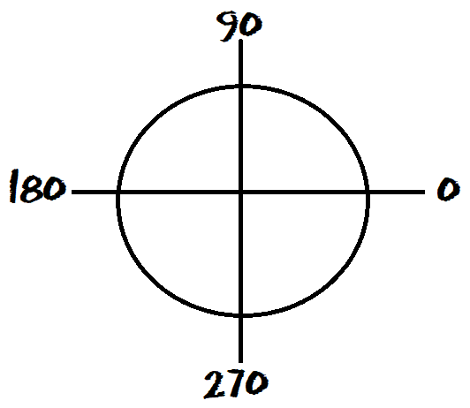
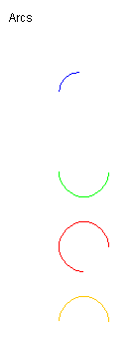
Arcs
window.setColor(Color.BLUE);
window.drawArc(100,100,40,40,90,90);
window.setColor(Color.GREEN);
window.drawArc(100,175,50,50,0,-180);
window.setColor(Color.RED);
window.drawArc(100,250,50,50,0,270);
window.setColor(Color.ORANGE);
window.drawArc(100,325,50,50,180,-180);
//drawArc(int x, int y, int width, int height, int startAngle, int arcAngle)
Notes:
The paint() method is typically doing the most drawing. Other methods may be called from paint() as well.

Slide 14
Graphics Runner
public class GraphicsRunner extends JFrame
{
//variables not shown
public GraphicsRunner()
{
setSize(WIDTH,HEIGHT);
getContentPane().add( new Circles() );
setVisible(true);
}
//main not shown
}
GraphicsRunner is used to
run all of the drawing and
graphics code.
Notes:
When a GraphicsRunner class is instantiated, the size of the JFrame is set and the visibility is also set.
The setSize() method sets the width and height of the JFrame.
The setSize() method tells the simply to either show the JFrame or hide the Frame.
The add() method adds a Component to the JFrame. A new Circles() Object is being instantiated and added to the JFrame.

Slide 15
Constructors
public class GraphicsRunner extends JFrame
{
private static final int WIDTH = 640;
private static final int HEIGHT = 480;
public GraphicsRunner()
{
setSize(WIDTH,HEIGHT);
getContentPane().add( new Circles() );
setVisible(true);
}
public static void main( String args[] )
{
GraphicsRunner run = new GraphicsRunner();
}
}
the constructor
constructor call
Notes:
When a GraphicsRunner class is instantiated, the size of the JFrame is set and the visibility is also set. The setSize() method sets the width and height of the JFrame. The setSize() method tells the simply to either show the JFrame or hide the Frame.
The add() method adds a Component to the JFrame. A new Circles() Object is being instantiated and added to the JFrame.

Slide 16
Running Examples
public class GraphicsRunner extends JFrame
{
//variables not shown
public GraphicsRunner()
{
setSize(WIDTH,HEIGHT);
getContentPane().add( new Circles() );
setVisible(true);
}
//main not shown
}
In the GraphicsRunner constructor, specify which example you wish to run.

Slide 17
Paint
public class Circles extends Canvas
{
//constructors
public void paint( Graphics window )
{
window.setColor(Color.BLACK);
window.drawString("Circles", 50, 50);
window.setColor(Color.BLUE);
window.drawOval(500,300,40,40);
}
//other methods
}
paint
paint() is called automatically when you instantiate the class containing the paint method.
When an event is triggered that requires a redraw, paint is called again.
To call paint() without a Graphics parameter, you can use the repaint() method.
Notes:
paint() is the method typically used to draw Graphics on the window. There are other methods that could be used, but paint() is used most frequently.
paint() is called when the window needs to be redrawn. If an event occurs that requires the window be updated, the system will call paint().
paint() can be called without a Graphics parameter by simply using the repaint() method.
paintComponent() is another method used for drawing / redrawing the window.

Slide 18
graphicsrunner.java
rectangles.java circles.java arcs.java

Slide 19
lines.ava
fonts.java
colors.java

Slide 20
Work on Programs!
Crank
Some Code!

